Slide 1

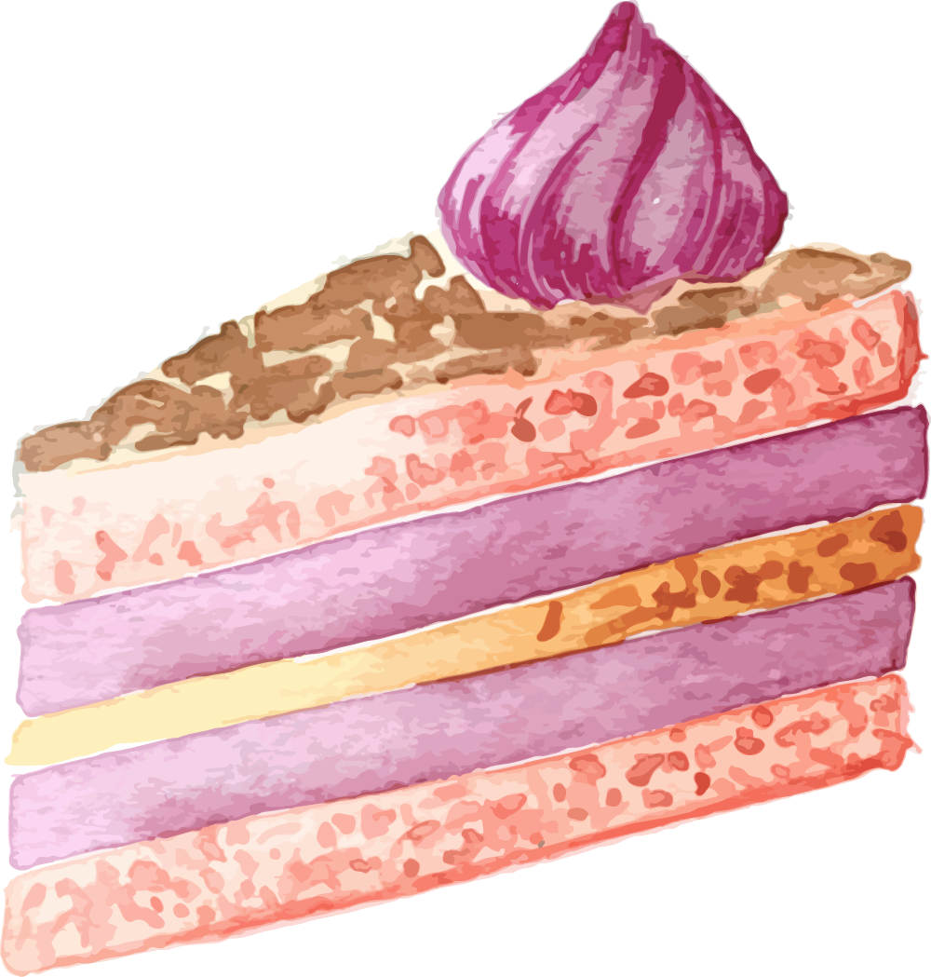


Dough Re Mi Bakery
prototype

Slide 2
What is the product/service that will address the problem/gap?
Reduce food waste as consumers are less likely to buy ‘ugly’ fruits that are unappealing to eat.
Does not contain
Eggs for gluten-free diet or due to their religion
Milk for dairy-free diet
Alcohol or Gelatin for Muslim people
Lower in sugar for diabetics and to reduce daily sugar intake
Made with low calories ingredients
Target audience: Diabetics, people who are on a gluten-free or dairy-free diet and people who are conscious about their diet.
Notes:
Source for ‘ugly fruits’ : https://www.straitstimes.com/singapore/meet-the-people-getting-ugly-food-onto-plates-and-away-from-the-bin

Slide 3
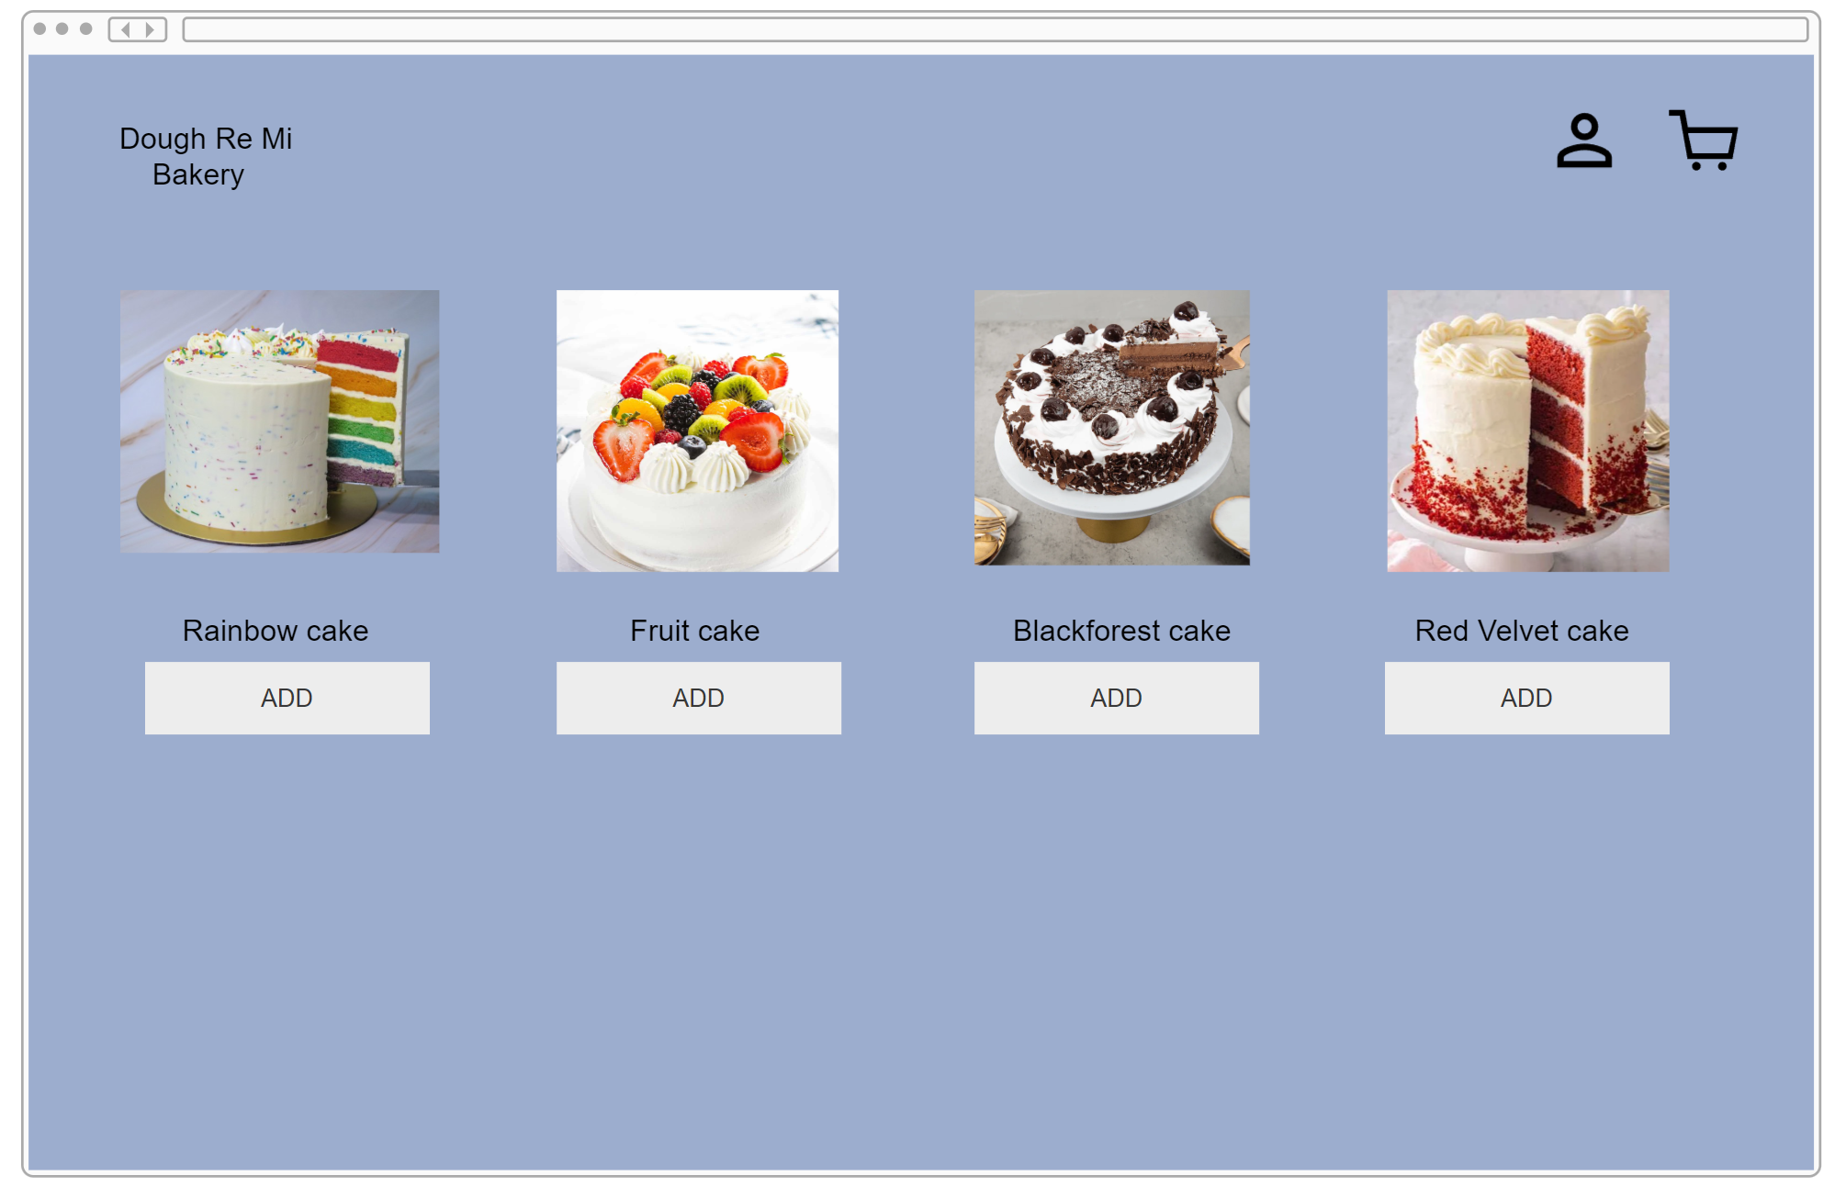

Slide 4
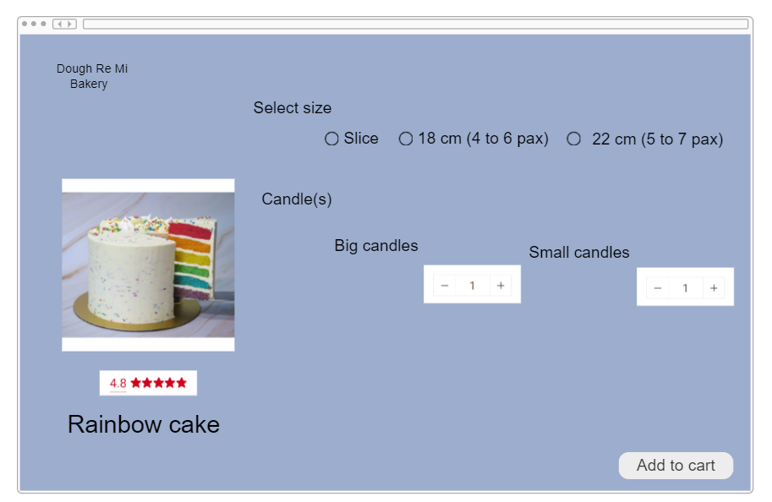
`

Slide 5
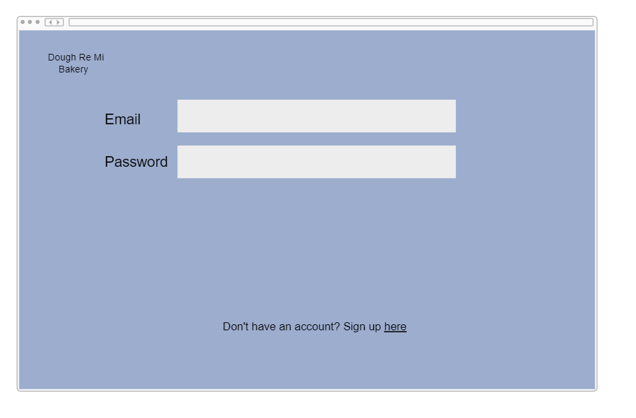

Slide 6
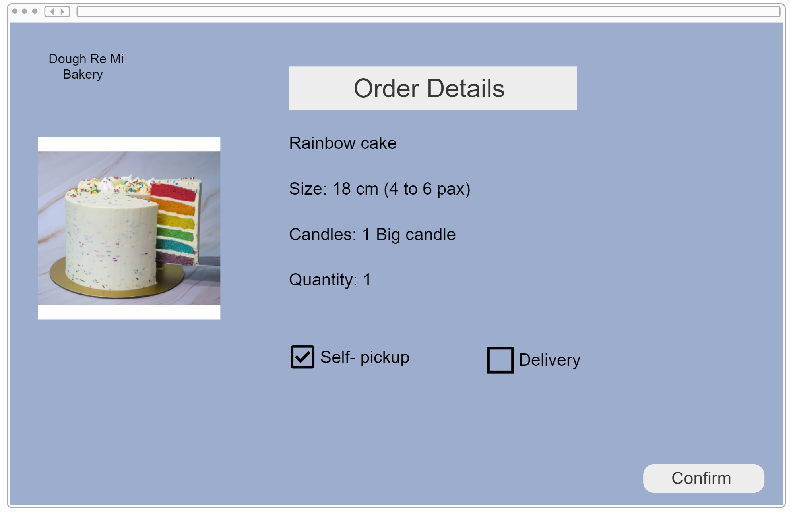

Slide 7
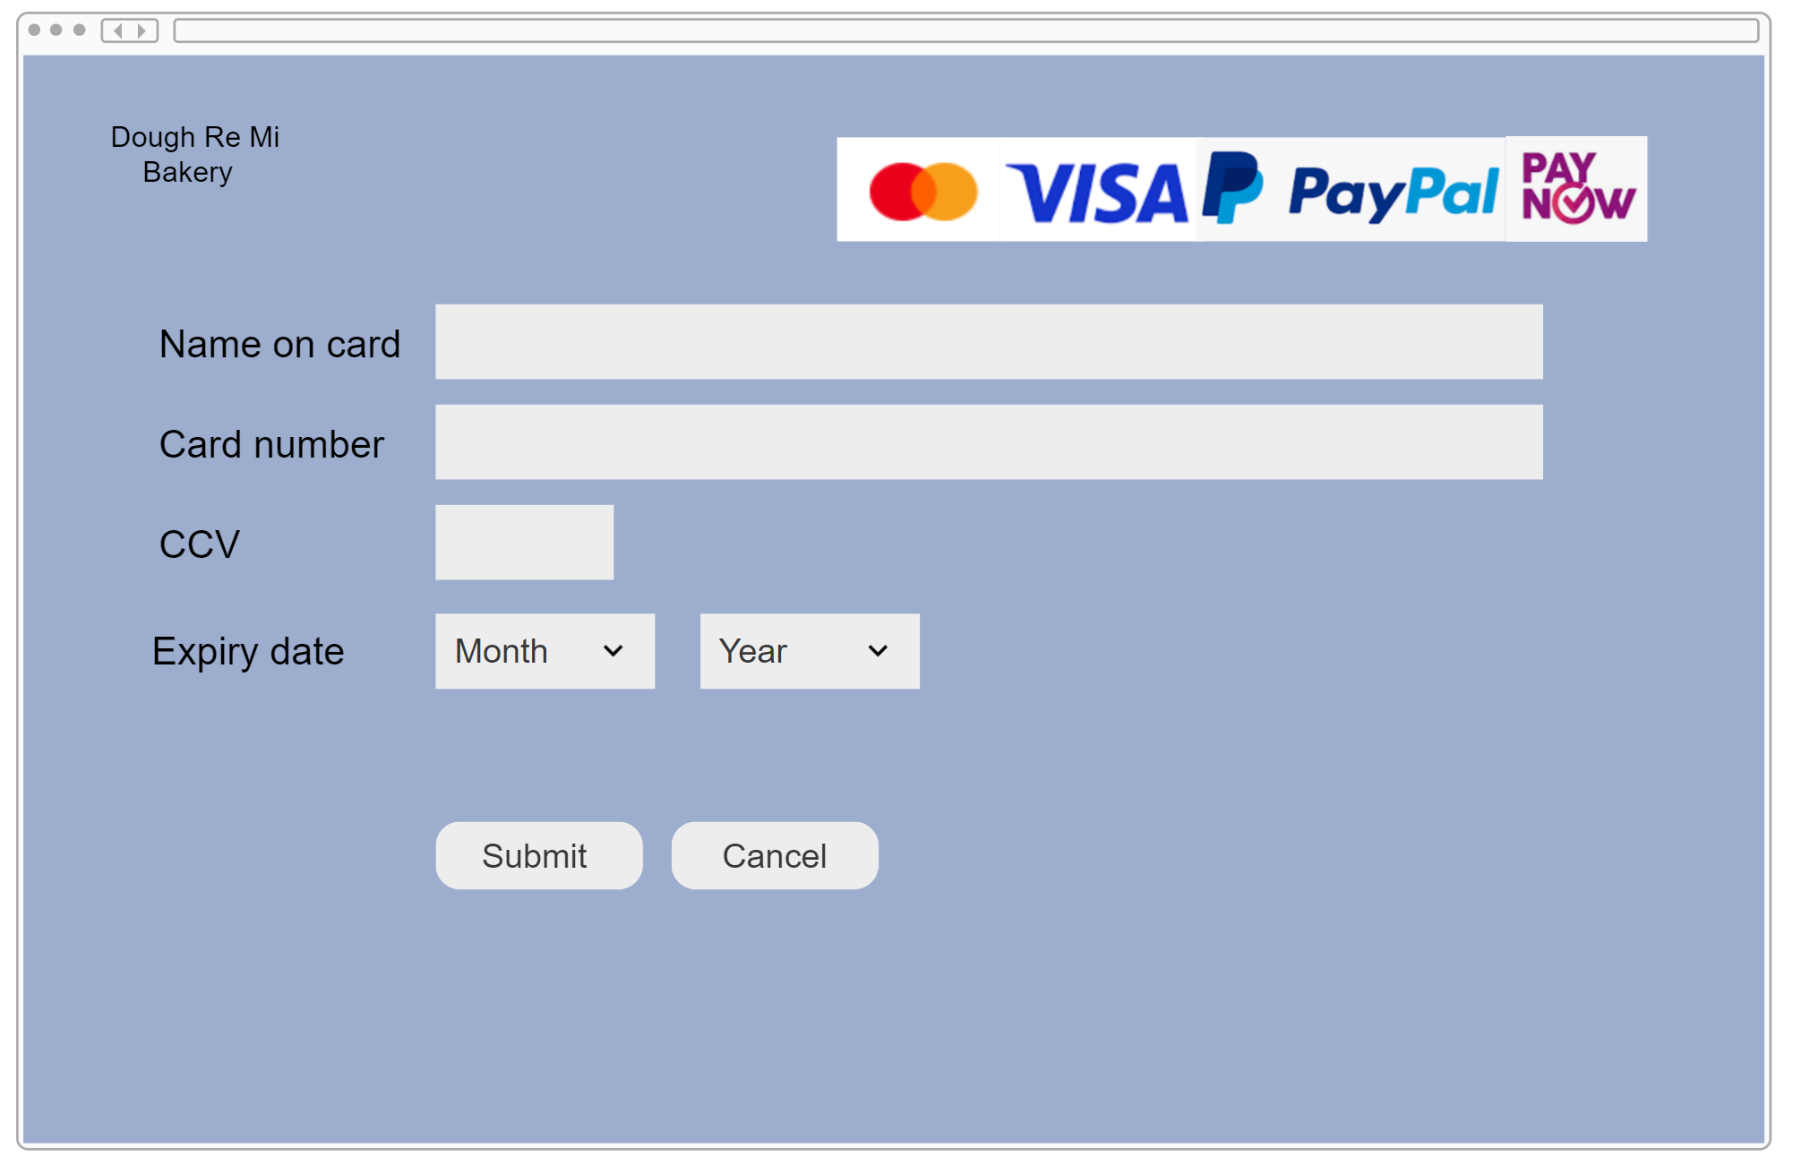

Slide 8
What is Dough Re Mi Bakery different from other companies?
Made with less sugar
Lower in calories
Not halal-certified but all the cakes does not have any alcohol or gelatin
No eggs or milk
No artificial colouring or flavoring
Made with ‘ugly’ fruits
Notes:
Source for ‘ugly fruits’ : https://www.straitstimes.com/singapore/meet-the-people-getting-ugly-food-onto-plates-and-away-from-the-bin

Slide 9
Design & Features of Dough Re Mi Bakery prototype website
Homepage
Displays the different kinds of cakes Dough Re Mi Bakery offers
Hover over the images of the cake
To see the description of the cake
Add button
Brings user to cart page
Human icon
When clicked, it brings the user to login/signup which allows them to use vouchers such as new user, returning customer, birthday
Cart icon
Shows the number of items in the cart
When clicked, it brings the user to the cart page
Cart page
Select the variations before checking out their order
Checkout page
Shows the order details before proceeding to the payment page
Payment page
For users to key in their card details to make payment

